Slide 1


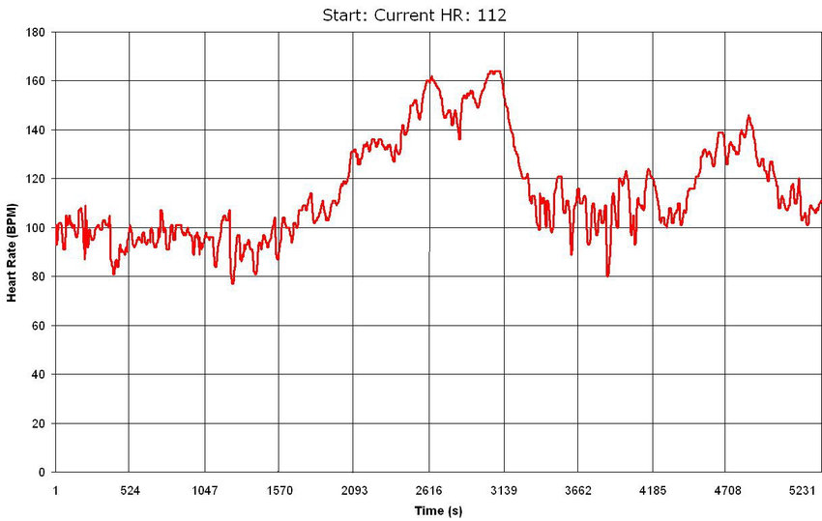
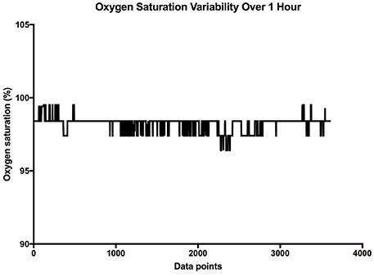
Doctor
Shows if the patient is connected to the server
Room B.126
Patient 1
good
Not alarming

Slide 2
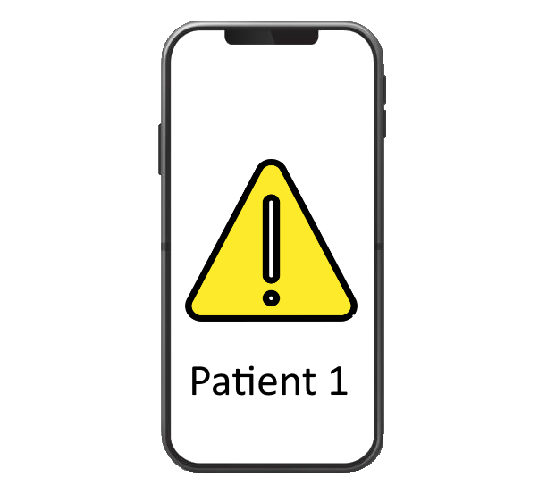
Nurse
Oxygen content or pulse
What is wrong?
good
Not alarming
Room B.126
Room B.126

Slide 3
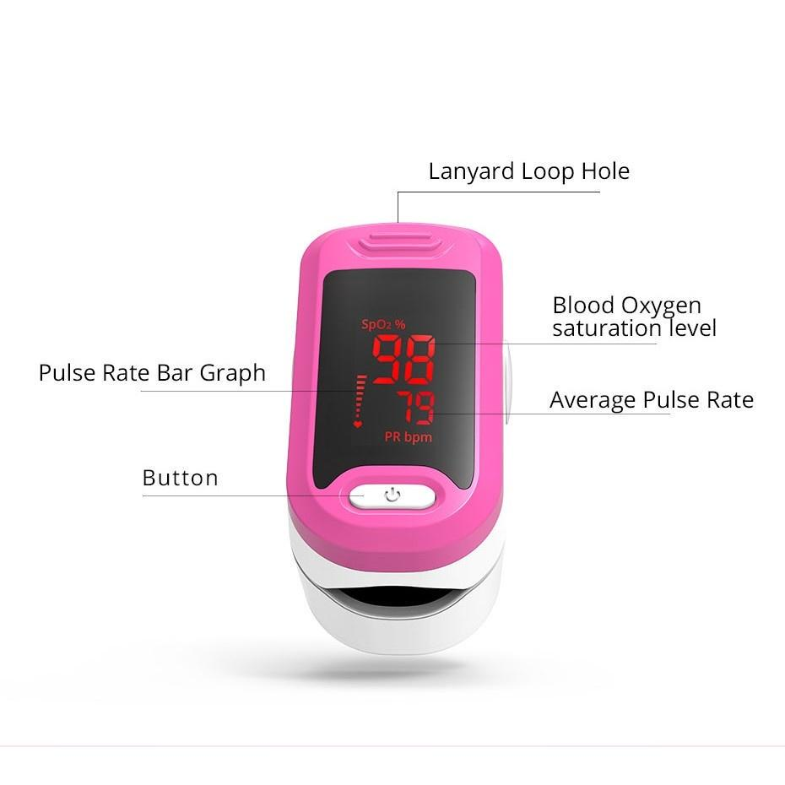
Patient

